Slide 1
Mobile Devices
Intro

Slide 2
Hey, I’m
Eric
eric.batlle@citm.upc.edu

Slide 3







Slide 4
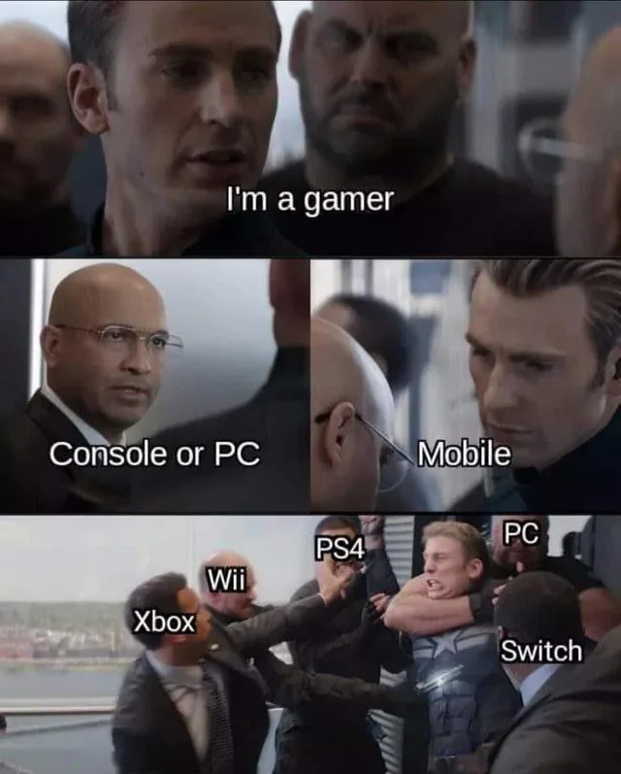

Slide 5
Why should I even care about developing games for…
MOBILE?

Slide 6
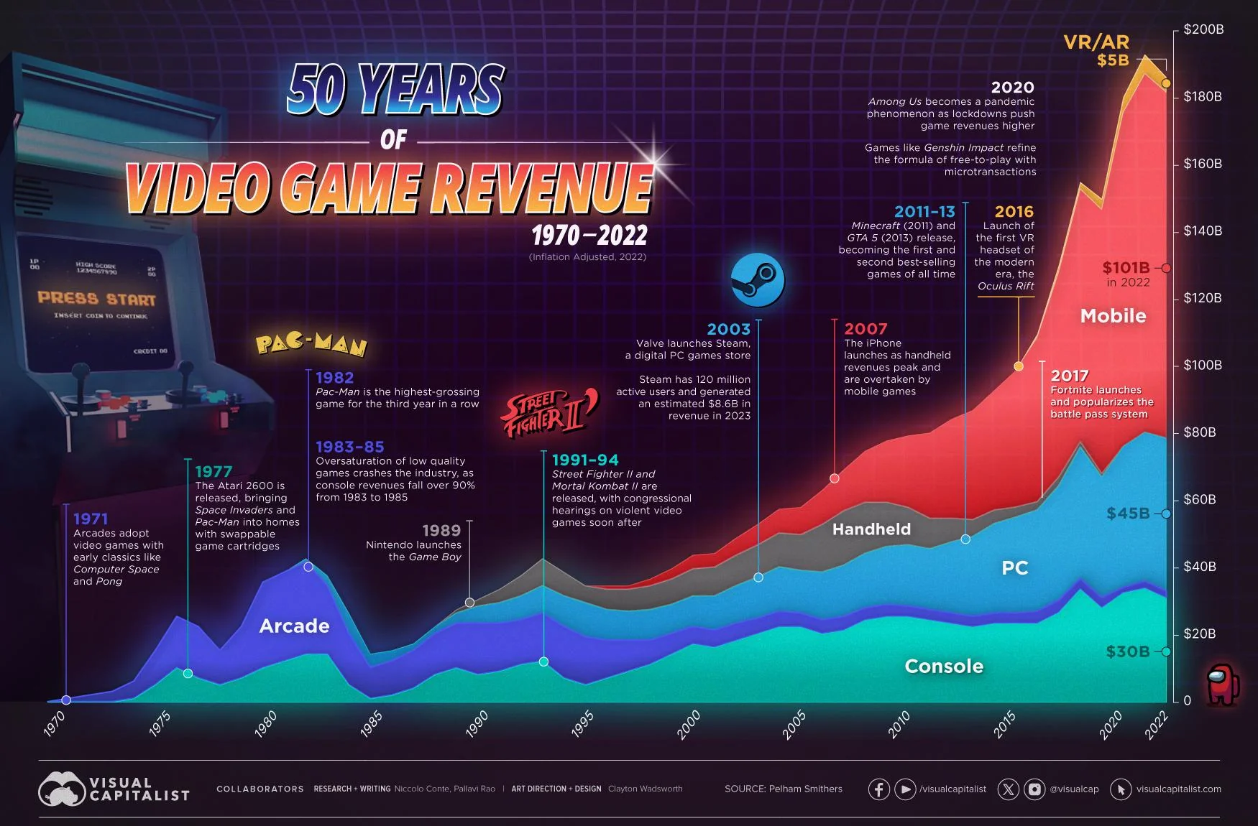

Slide 7
But I don’t care about money! I just want to make
GREAT VIDEOGAMES!

Slide 8
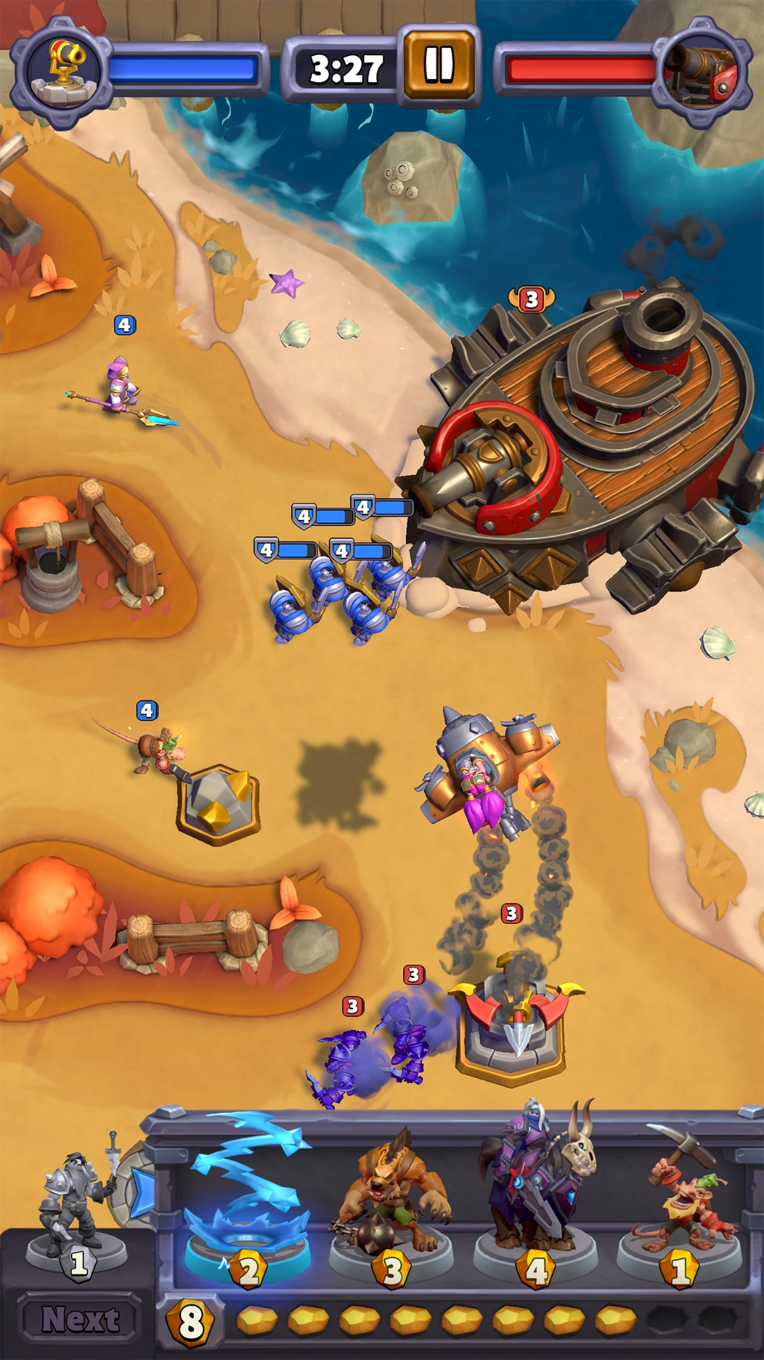
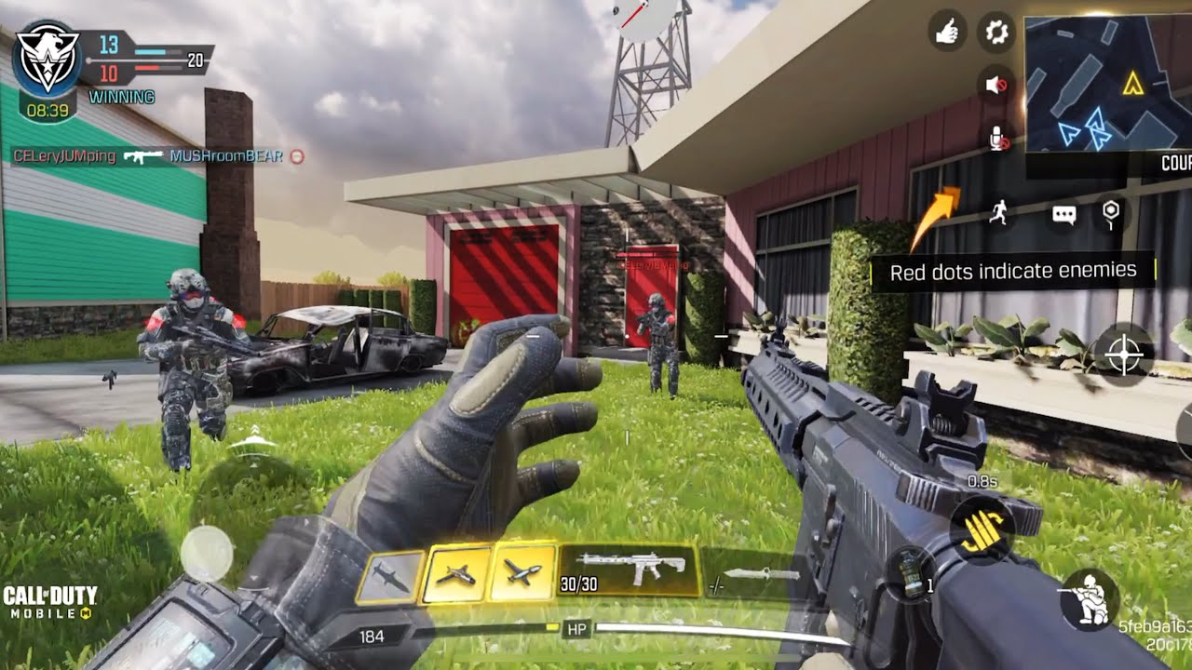
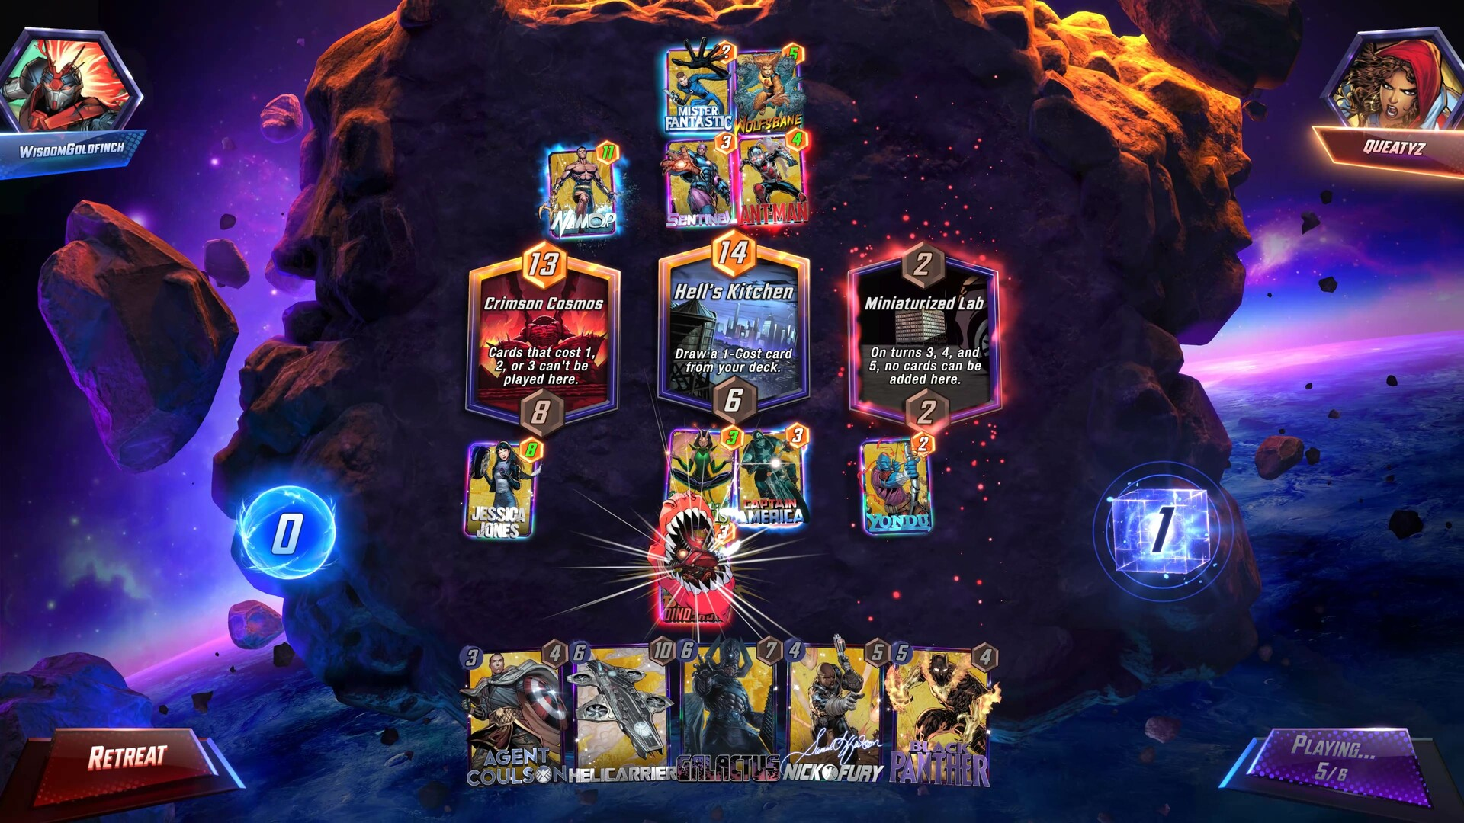

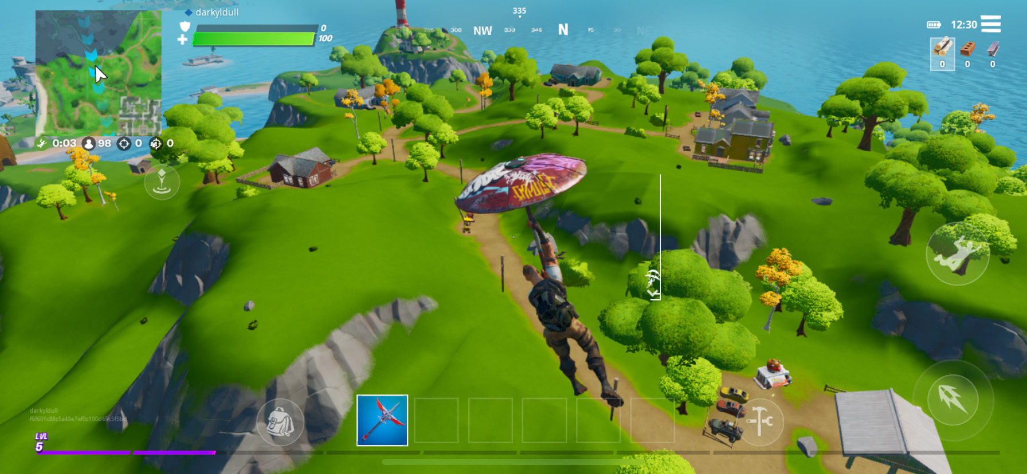
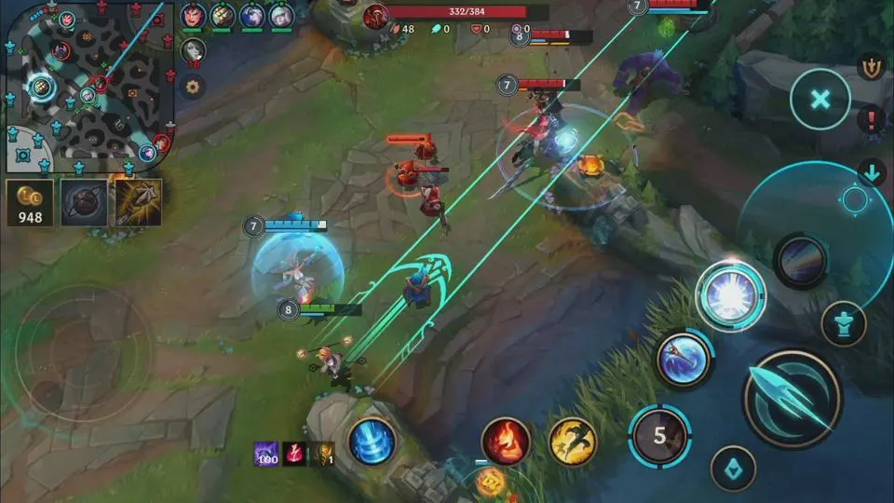
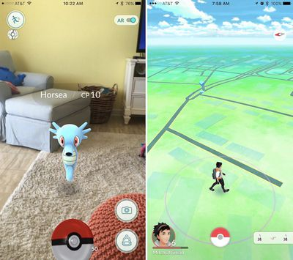
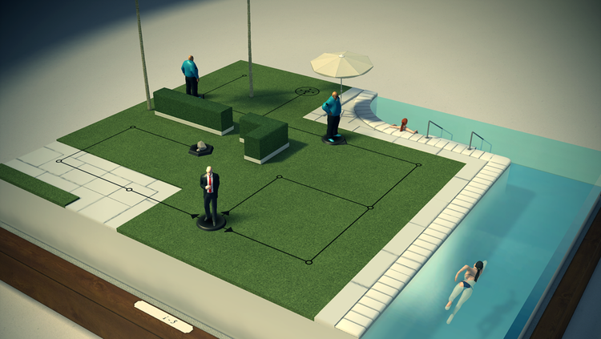

Slide 9
Whatever, I just want to work for
MY FAVORITE COMPANIES!

Slide 10
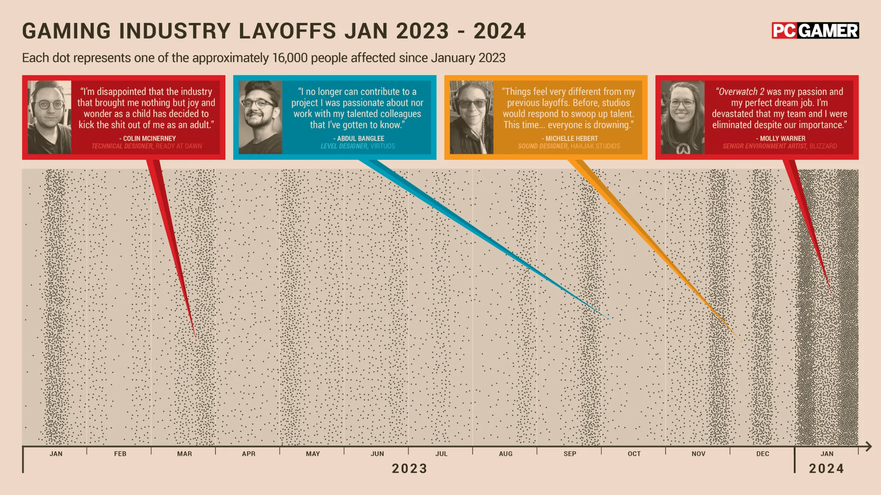

Slide 11
Oh…
Then I’ll be an Indie dev and work for..
MYSELF?

Slide 12
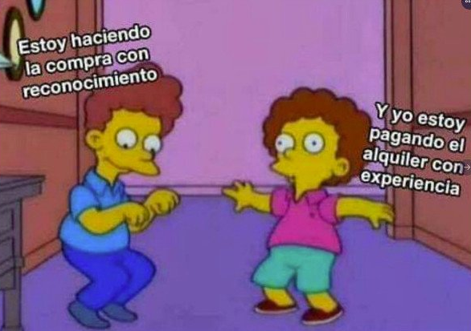
I’m doing my grocery shopping with gratitude
And I’m paying my rent with experience!

Slide 13
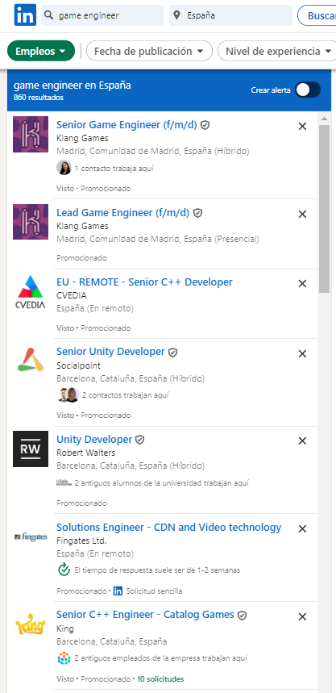
Finding job: Mobile vs PC
Mobile Gaming Development
PC/Other Gaming Development
LinkedIn quick search with name filter “game engineer”

Slide 14
The Reality
Indie game development is a huge risk cause market is oversaturated
There are more job offers for Mobile video games
Mobile video game companies usually pay an average of 20-40% more than majority of other PC or console companies (at least to the engineers)

Slide 15
Okey, maybe I can consider learning some mobile stuff…
HOW?

Slide 16
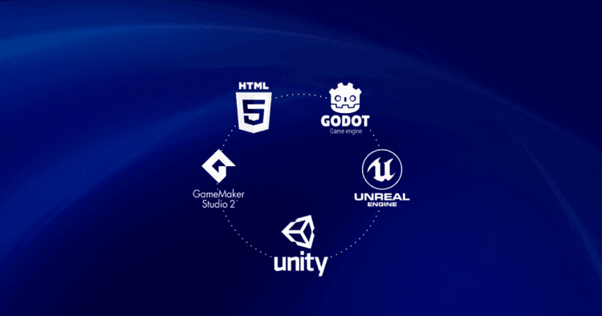

Slide 17
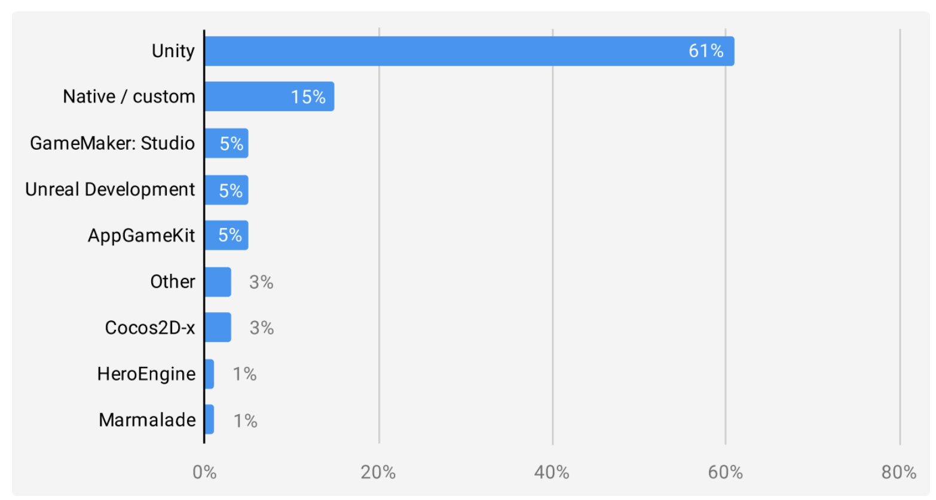
Mobile games market share per engine, for 2021

Slide 18
This is from 2021, Unity has flopped this year…
NO?

Slide 19
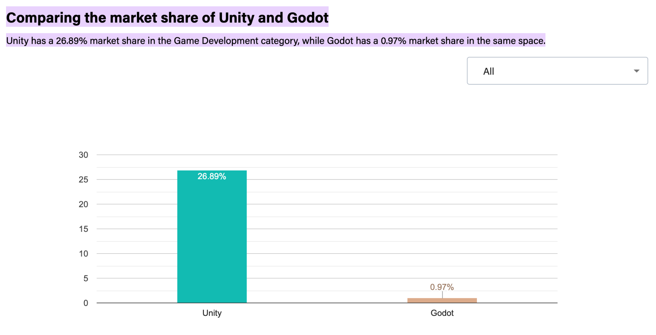

Slide 20
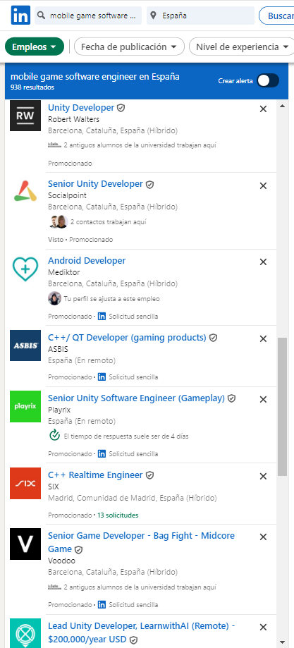
Finding job: Unity vs Godot
Unity
Other
Godot
???
LinkedIn quick search with name filter “mobile game software engineer”
If you search “godot”, you obtain 0 results, but with “unity” you obtain 297.

Slide 21
Understood.
What now?

Slide 22
Subject Content
Unity Essentials | C# and Software Architecture | Advanced Unity
Editor 3D 2D Audio Scripting | C# OOP Design Patterns | Persistance Tooling Assemblies Testing Scriptable Objects Asynchronous programming Addressables

Slide 23
Evaluation Criteria
Oral Presentation I | 5%
Oral Presentation 2 + code sample deliver | 5%
Theory Exam | 20%
Individual scoped videogame deliver | 20%
Final Team Deliver I | 10%
Final Team Deliver II | 30%
Attendance | 10%

Slide 24
Re-Evaluation Criteria
In case of failing the subject (<5):
Recover the Theory exam
You can only recover the score from that Theory exam
Remember that Theory Exam is 20% of the Final Score
That means that if your final score before re-evaluation is < 3, recovery won’t save you
The maximum amount of Final Score you can receive after a re-evaluation is 5
Remember that all presentations and theory exams require presence.
Unjustified absence equals 0.

Slide 25
Unity Essentials
Link: https://learn.unity.com/pathway/unity-essentials?language=en
Badge recognized by Digital Badges and Unity
We are going to fulfill all chapters except 4 and 6
Chapter 4 is about scripting, I assume you already have some basics, so we are going to go through it fast
Chapter 6 is about publishing, which is not a main objective for the course, so we are going to cover only if time allows us to do so
After completing chapters, we are going to enhance the knowledge with some Tips and tricks, or knowledge from the industry insights
Remember that the version of Unity that we’re going to use is: 2022.3.44f1

